Slide 1
DOR
-Ambuj Mishra
-2021PCS1017

Slide 2
Assignment-3

Slide 3
Pre-processing techniques
Tokenization
Converting to lower case
Removing punctuation and special symbols
Removing blank spaces
Removing stopwords
Lemmatization

Slide 4
Assignment-4
Pre-processing is performed.
Postings and term document frequency dictionary is created.
Vocabulary is maintained.

Slide 5
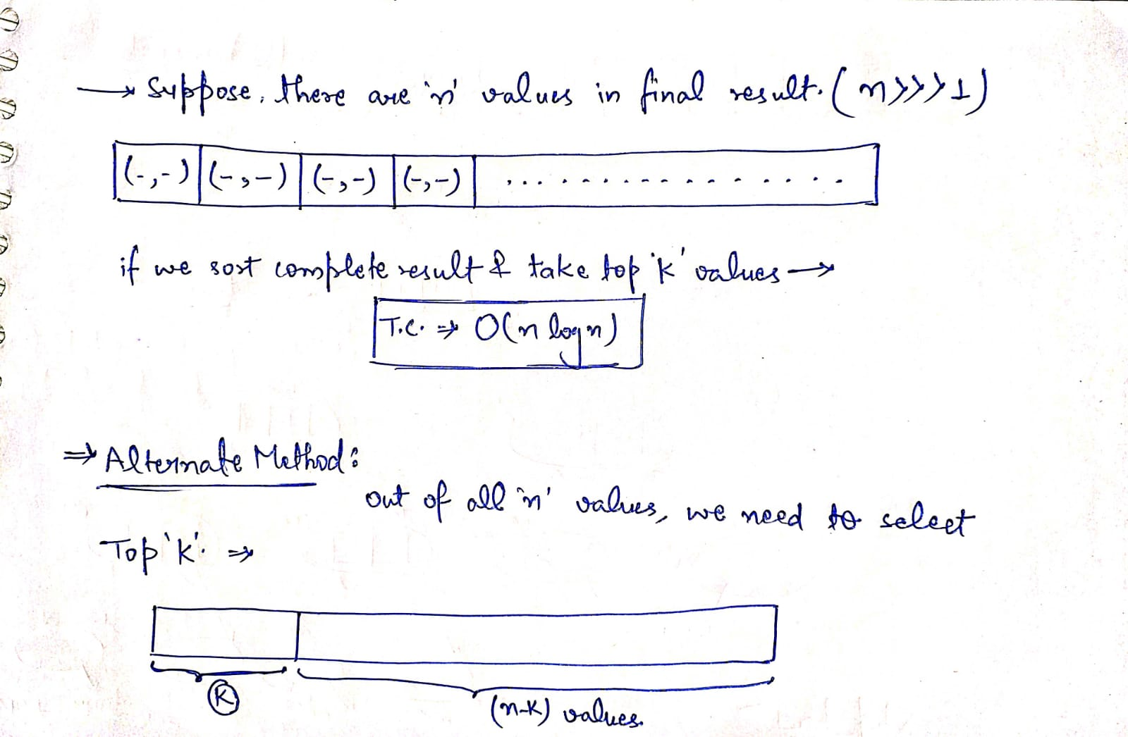
Sorting Method

Slide 6
Algorithm

Slide 7
